Slide 1
Integrated University Department Information System
By Vaishnavi Bhambure Prof Dr. Ennoure

Slide 2
The Software
Integrated University Department Information System
Solution to a Disembodied University
Aggregate Department’s Finances using a Tallying System
Conducts Minute Operations that interconnects Department to the larger University System

Slide 3
Overview
Software Overview
Requirements
ER diagram
Classes
Architecture
Summary

Slide 4
Software Overview
Interaction
The Budget System
The Database system for the department
Large University System
Regulation
Student Records
Laboratory Administration
The Ordering of Goods & Services
The Management of Account Receivable & Payable

Slide 5
Software Overview(contd)
Actors and Resources
Students
Professors
Administrator
Third Party goods/service providers
Department Database

Slide 6
Requirements
1. Administrators/Officials must be able to create/modify/delete/view class.
2. Administrators/Officials must be able to create/modify/delete/view any user account.
3. Officials from university system must be able to handle all expenses.
4. There must be a payable and receivable system.
5. Administrators must have access to entire IUDIS and its database.
6. There must be a way for users to login and logout.

Slide 7
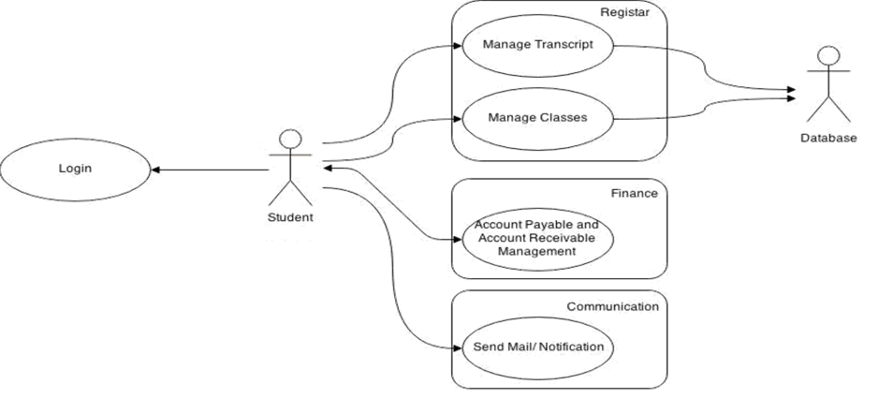
Requirements (Student)

Slide 8
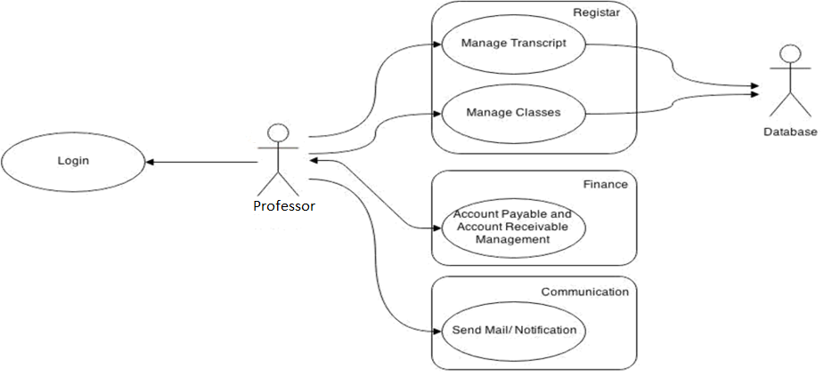
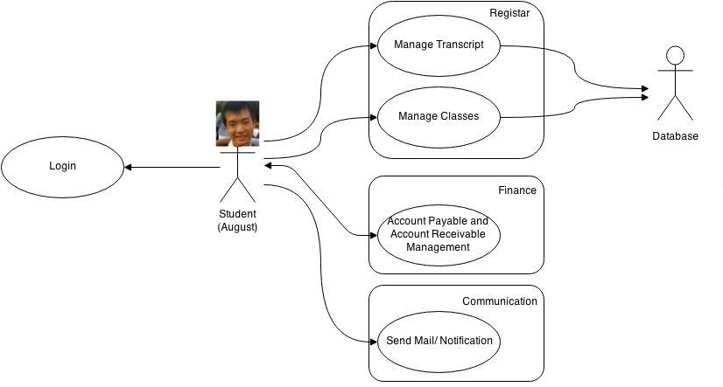
Requirements (Professor)

Slide 9
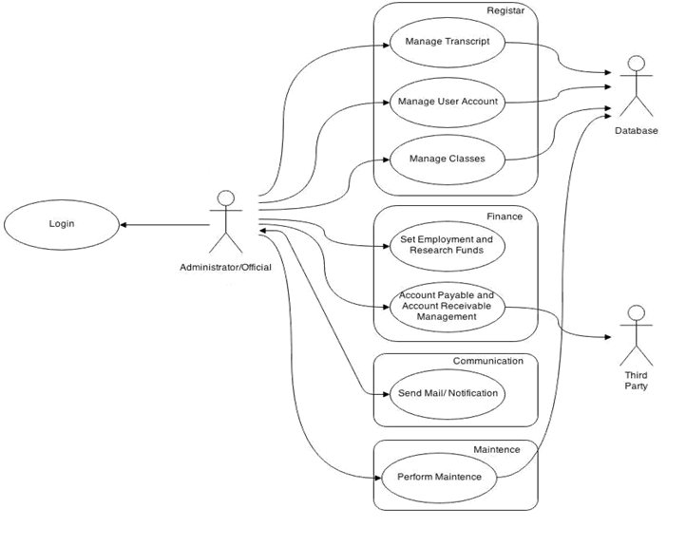
Requirements (Admin)

Slide 10
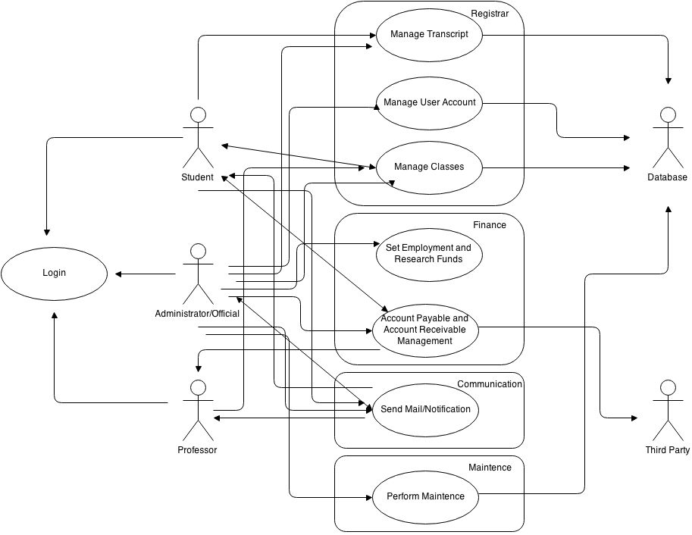
Requirements (Entire Use Case Diagram)

Slide 11
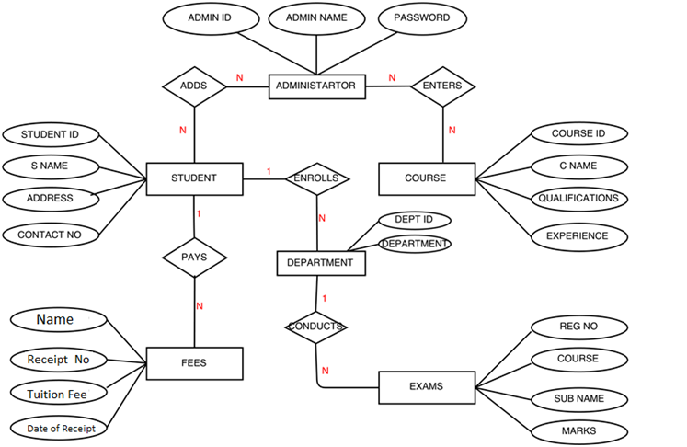
ER Diagram

Slide 12
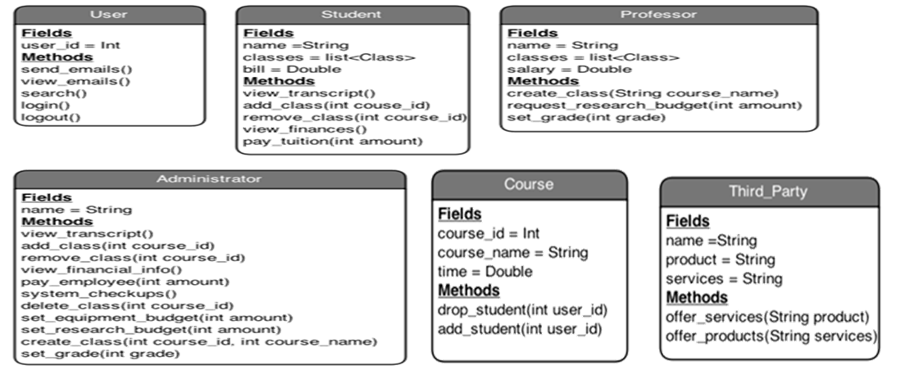
Class Diagram

Slide 13
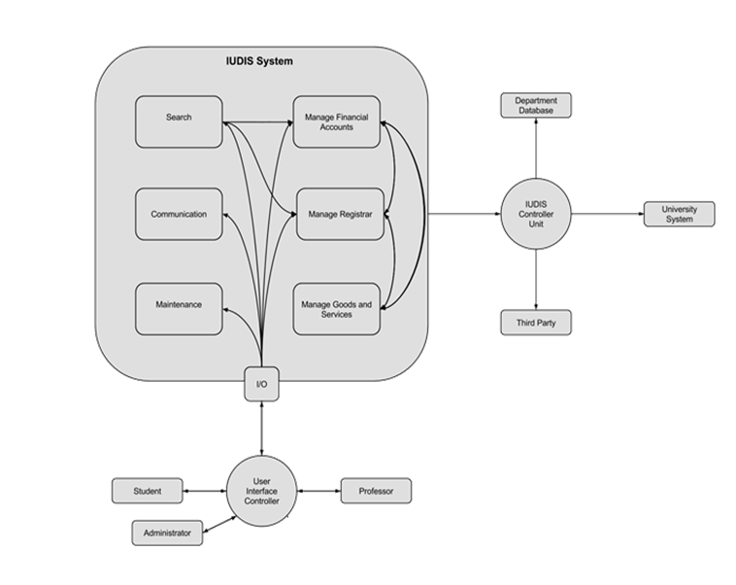
Architecture Diagram

Slide 14

Demonstration
Refer to Demo Screen

Slide 15
Advantage
One system to manage
Fast access to all user information
Easy update for all information
Efficient and consistent updates
No information differences from disembodied system
No confusion from separate systems

Slide 16
Integrated University Department Information System
By Vaishnavi Bhambure Prof. Dr.Ennoure

Slide 17
Thank You

